Slide 1
Atomic Structure 3D visualization via Python
Jason Kim

Slide 2
Project Introduction
Atomic simulation of compounds and visual library in 3-dimensional visualization
Displays name, chemical and physical properties of the compound
If possible, make it compatible with virtual reality

Slide 3
Technology Used
Periodic Table API
VPython for 3D visualization modelling
Not decided on which search algorithm to use (most likely jump search)
User interface (pyqt-depth or tkinter-simple)

Slide 4
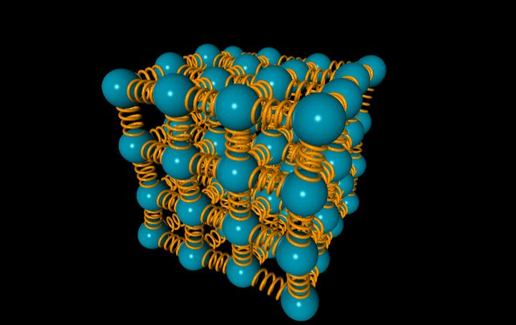
Features
Visualize Atomic structures with user interface (input elements and place at desired locations)
Display chemical and physical properties of the created compound
If possible, adjust user interface to work with VR
[1] Example of compound structure visualization

Slide 5
Implementations (Rough Draft)
Program
Understand VPython and create virtual space and atom models
Import Periodic Table API and connect with atom models
Connect atom models with chains and redefine structures
User Interface
Create user interface such as element selection and atom and chain placement
If possible, create interface within VR settings

Slide 6
Implementations (Concerns)
Potential Difficulties
Library for compounds (too widespread and not organized unless common)
Using unfamiliar library and programs such as VPython and Python GUI

Slide 7
Reference
[1] GlowScriptDemos - https://www.glowscript.org/#/user/GlowScriptDemos/folder/Examples/program/AtomicSolid-VPython

